Slide 1
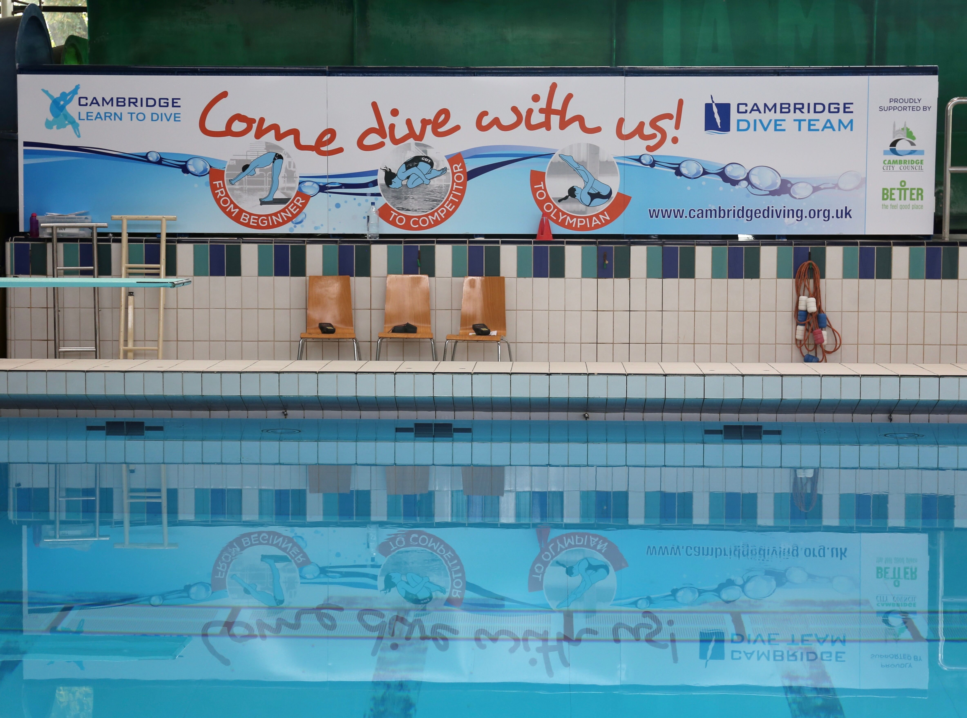
Adult Learn To Dive
Mondays and Thursdays 8.30-9.30pm
For bookings contact Nuala: learntodive@cambridgediving.org.uk
Student discount available!
ALL ABILITIES
First session FREE!

